Slide 1
Faster R-CNN:Towards Real-Time Object Detection with Region Proposal Networks
汇报人：管颢筌

Slide 2
1. Introduction
Object detection networks depend on region proposal algorithms to hypothesize object locations.
Recent advances in object detection are driven by the success of region proposal methods and region-based convolutional neural networks (R-CNNs)
Fast R-CNN, achieves near real-time rates using very deep networks when ignoring the time spent on region proposals.
proposals are the test-time computational bottleneck in state-of-the-art detection systems.

Slide 3
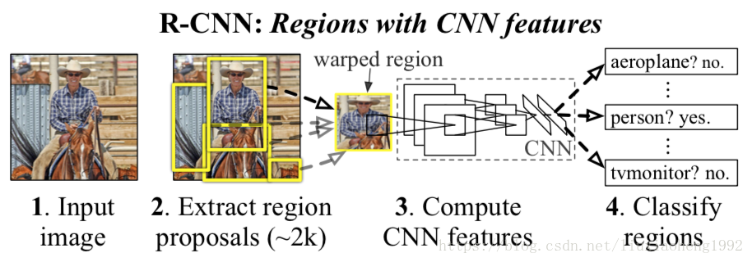
Region proposal methods typically rely on inexpensive features and economical inference schemes.
Selective Search , one of the most popular methods,

Slide 4
computing proposals with a deep convolutional neural network
introduce novel Region Proposal Networks (RPNs) that share convolutional layers with state-of-the-art object detection networks .
anchor

Slide 5
2.Faster RCNN architecture
The first module is a deep fully convolutional network that proposes regions.
and the second module is the Fast R-CNN detector that uses the proposed regions.

Slide 6
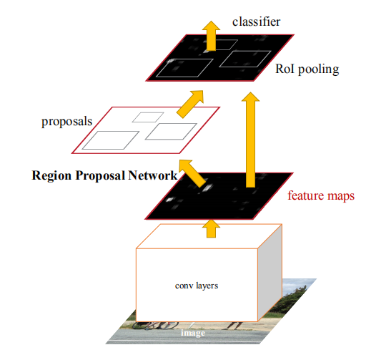

Slide 7
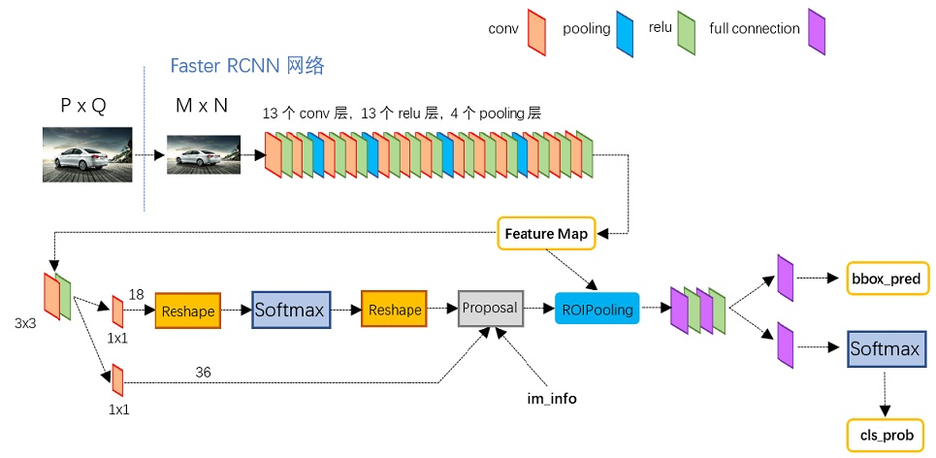

Slide 8
3. Anchors
An anchor is centered at the sliding window in question, and is associated with a scale and aspect ratio .
By default we use 3 scales and 3 aspect ratios, yielding k = 9 anchors at each slidingposition. For a convolutional feature map of a size W × H (typically ∼2,400), there are W*H*k anchors in total.

Slide 9
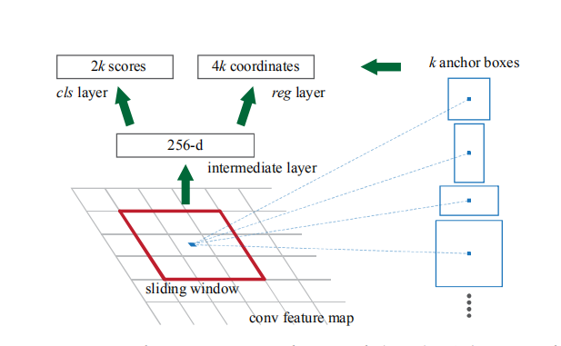

Slide 10
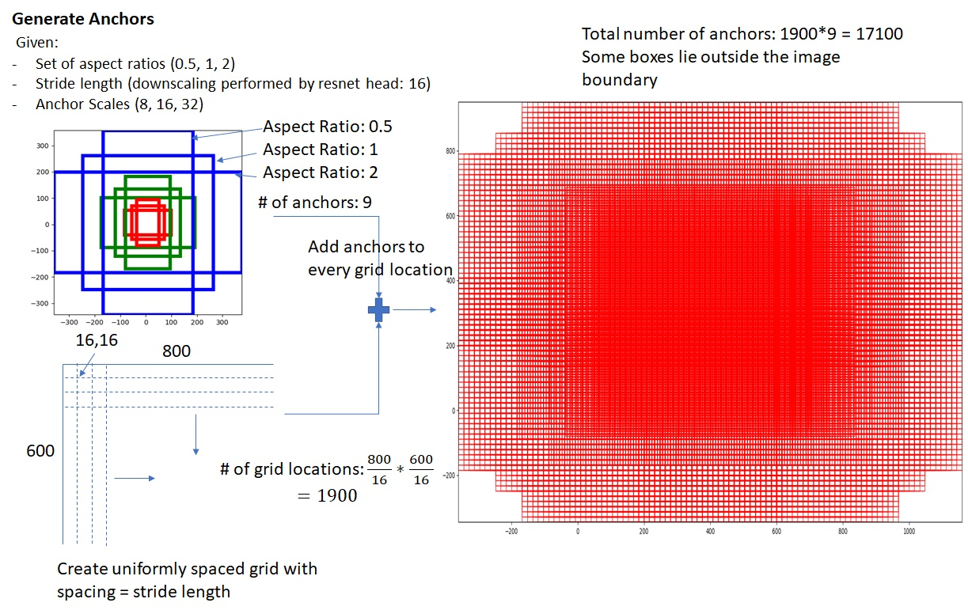

Slide 11
4.Loss Function
we assign a binary class label (of being an object or not) to each anchor.
We assign a positive label to two kinds of anchors: (i) the anchor/anchors with the highest Intersection-over-Union (IoU) overlap with a ground-truth box,
We assign a negative label to a non-positive anchor if its IoU ratio is lower than 0.3 for all ground-truth boxes. Anchors that are neither positive nor negative do not contribute to the training objective.

Slide 12
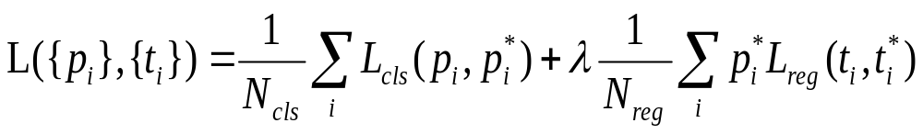


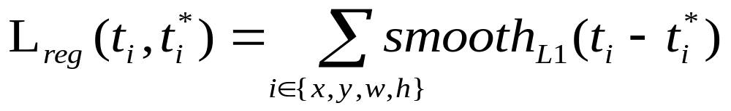
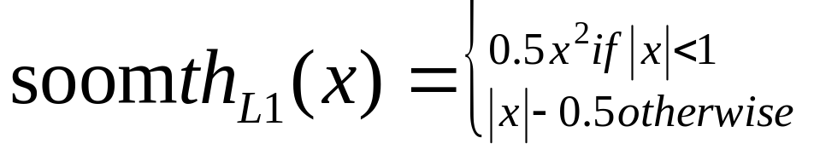
i : anchor index : positive softmax probability
ground-truth predict (IoU>0.7 =1;IoU<0.3 =0)
t : predict bounding box
t* : positive anchor→ground-truth

Slide 13

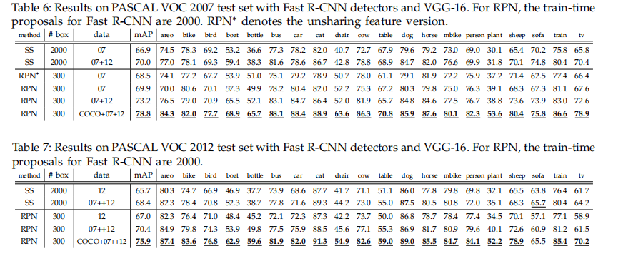
5. Experiments on PASCAL VOC

Slide 14
Thanks

